Slide 1
Bluetooth Techniques
Chapter 15

Slide 2
Overview
Universal short-range wireless capability
Uses 2.4-GHz band
Available globally for unlicensed users
Devices within 10 m can share up to 720 kbps of capacity
Supports open-ended list of applications
  Data, audio, graphics, video

Slide 3
Bluetooth Application Areas
Data and voice access points
  Real-time voice and data transmissions
Cable replacement
  Eliminates need for numerous cable attachments for connection
Ad hoc networking
  Device with Bluetooth radio can establish connection with another when in range

Slide 4
Usage Models
File transfer
Internet bridge
LAN access
Synchronization
Three-in-one phone
Headset

Slide 5
Piconets and Scatternets
Piconet
  Basic unit of Bluetooth networking
  Master and one to seven slave devices
  Master determines channel and phase
Scatternet
  Device in one piconet may exist as master or slave in another piconet
  Allows many devices to share same area
  Makes efficient use of bandwidth

Slide 6
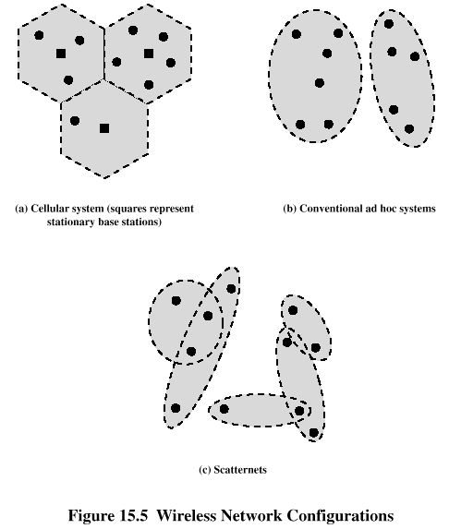
Wireless Network Configurations

Slide 7
Frequency Hopping in Bluetooth
Provides resistance to interference and multipath effects
Provides a form of multiple access among co-located devices in different piconets

Slide 8
Frequency Hopping
Total bandwidth divided into 1MHz physical channels
FH occurs by jumping from one channel to another in pseudorandom sequence
Hopping sequence shared with all devices on piconet
Piconet access:
  Bluetooth devices use time division duplex (TDD)
  Access technique is TDMA
  FH-TDD-TDMA

Slide 9
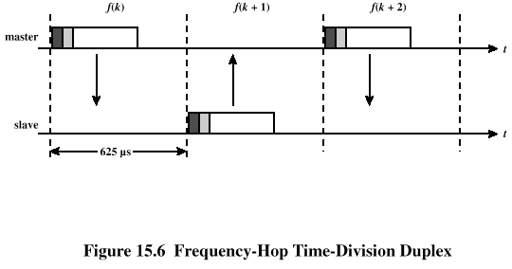
Frequency Hopping

Slide 10
Bluetooth Audio
Voice encoding schemes:
  Pulse code modulation (PCM)
  Continuously variable slope delta (CVSD) modulation
Choice of scheme made by link manager
  Negotiates most appropriate scheme for application

